Slide 1
Medical Appointment No Shows Issue
Data Visualization Application
Hsuan-ju Lin

Slide 2
Context
Introduction
Research question
Dataset
Preprocess
Exploratory Data Analysis
Findings
Future works
Appendix

Slide 3
Introduction
Managing patient scheduling is important to clinics. Overbooking could lead to employee burnout and patient dissatisfaction. In additions, patients no-show to the appointment causes opportunity loss for clinics. Thus, in this research I will address medical appointment no-show issue

Slide 4
Research Question
Build a model to discover who will not show up for medical appointment
1. Which model has a better performance to classify a no-show appointment?
logistic regression model vs. Random Forest model
2. What are the most important features for the appointment no-show?

Slide 5
Dataset
The dataset contains 110,527 medical appointments and its 14 associated variables. The most important one is no-show variable, the target variable for models, to indicate if the patient show-up or no-show to the appointment.
Features includes demographic variables( age, gender, neighborhood…), health status(diabetes, handicap…), schedule day, appointment day, and text message reminder

Slide 6
Preprocess
The dataset is clean without any null value
Create a “lead time for appointment” variable by subtracting schedule day from appointment day
Create dummy variables for categorical variables in order to build models using Python
* Dataset file name is “out.csv”

Slide 7
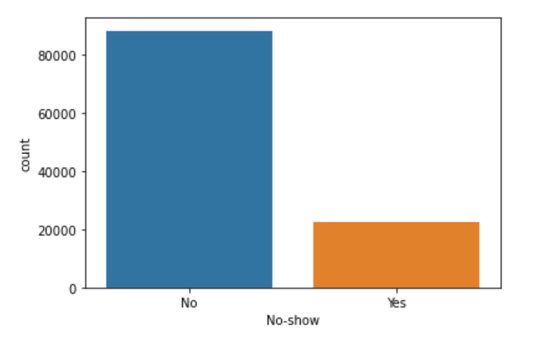
Exploratory Data Analysis Imbalanced Dataset
The distribution of 2 classes within the target variable, No-show, is unequal
Thus, I use oversampling to deal with imbalanced issue and choose recall to evaluate the performance instead of accuracy
* No-show label “Yes” means that the patient no-show to the appointment

Slide 8
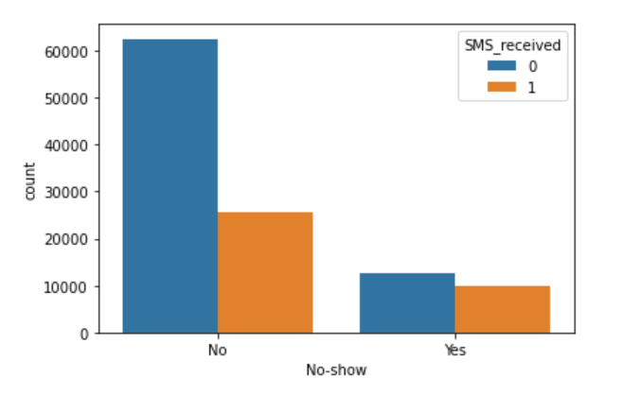
Exploratory Data Analysis No-show across SMS_received
It seems that there is a relationship between No-show and SMS_received because the bar charts differ across classes
p.s. bar plots for 2 categories have a strong visual impact than cross table to show the relationship
* SMS_received =1 means the patient get text message reminder

Slide 9
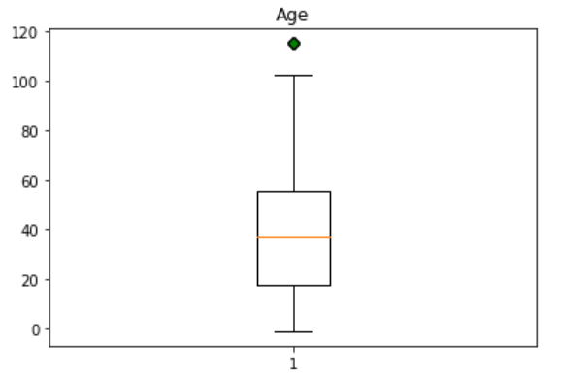
Exploratory Data Analysis 50% of the patients' age are between 20 and 50 years old
p.s. I have tried box plot and histogram to visualize the distribution of age, and find that box plot could present more information such as quantile

Slide 10
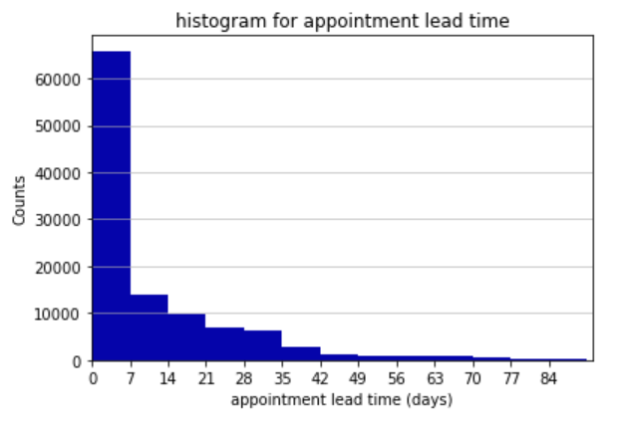
Exploratory Data Analysis Most of the appointments are made within 1 week

Slide 11
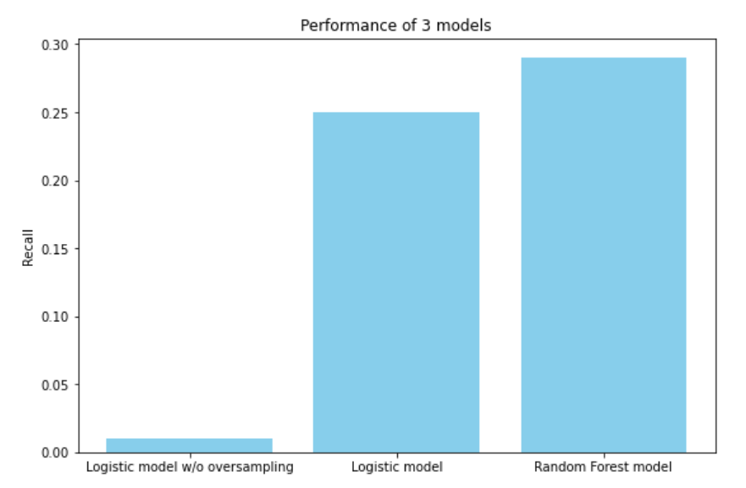
Findings Compare Performance of 3 models
The Random Forest model perform better than Logistic regression model
Oversampling helps to reach a better recall

Slide 12
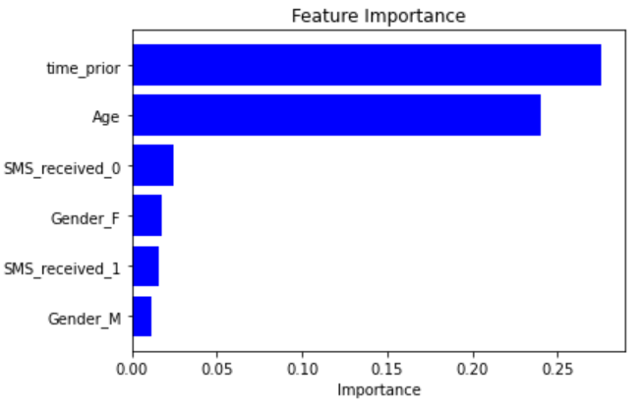
Findings the most important features
Time_prior (appointment for lead time) and age are important features to predict an appointment no-show
p.s. bar chart could show the difference clearly among features
* Feature importance is derived from Random Forest

Slide 13
Future works
Use grid search to find the optimal hyperparameters of models
Use different algorithms to get better performance

Slide 14
Appendix
Full Python code and graphs:
https://github.com/shanrulin/Individual_project-Medical-Appointment-No-Shows/blob/master/FE%20550-Individual%20project.ipynb

